Slide 1
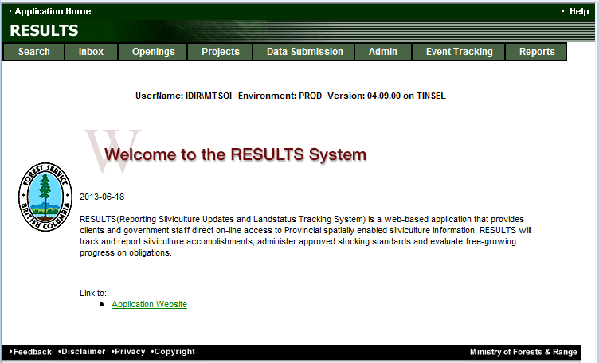
RESULTS Training
Core Module 7
Ministry Approver Processing
Sept 2013

Slide 2
LearningObjectives
Approver Responsibilities
Silviculture Prescription Amendments
S108 Application
Opening Amalgamation
Propose Stocking Standards

Slide 3
Approver Responsibilities
Approver status is assigned by the District Manager.
RESULTS Items requiring approval are:
  Silviculture Prescription Amendment (SUB)
  FRPA s.108 Application (RELIEF)
  Opening Amalgamation (AMG)
  Proposed Stocking Standards – Woodlots or for FDP (SUB)

Slide 4
Approver Responsibilities
Must be legal context, if applicable (silv prescription amendment);
Must be familiar with program directives, if applicable (s.108 application where funding applies, if approved must reflect funding availability) or any policy direction
Amalgamation ensuring that there is adequate follow up to clean-up opening post-approval
Proposed stocking standards is appropriate and there is nothing that is already available and it done through the proper process (FDP vs. FSP)

Slide 5
Silviculture Prescription Amendment

Slide 6
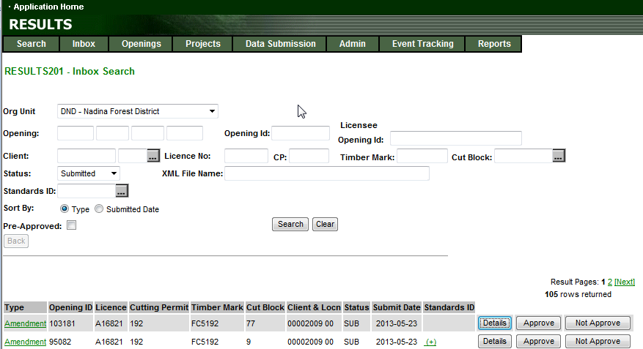
Silviculture Prescription Amendment (Proposed Amendment)
Filter on Status is in “SUB” status.
Type: Amendment (Silviculture Prescription Requiring Approval)
Review Details to see full content of the amendment

Slide 7
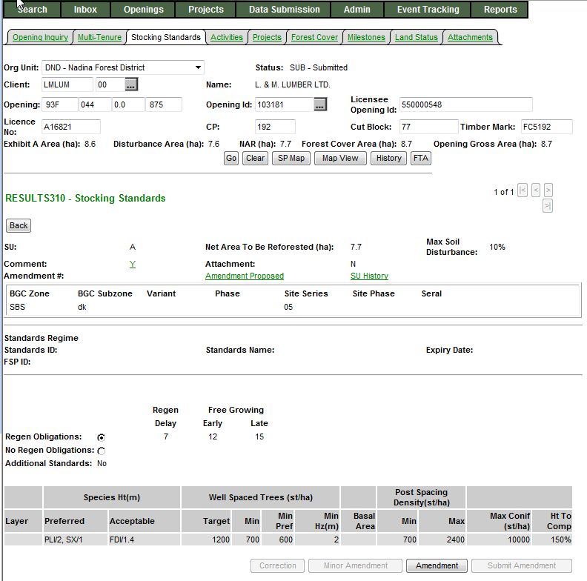
Silviculture Prescription Amendment (Proposed Amendment)
Status is in “SUB” status.
Can view Amendment using Amendment Proposed
Submitted Amendments cannot be modified.
Must proceed with processing the amendment.
If there is an error with submitted amendment must “Not Approve” in order to re-submit.
Cannot do approvals from S310 (View only). Approvals must be done in the S201 Inbox

Slide 8
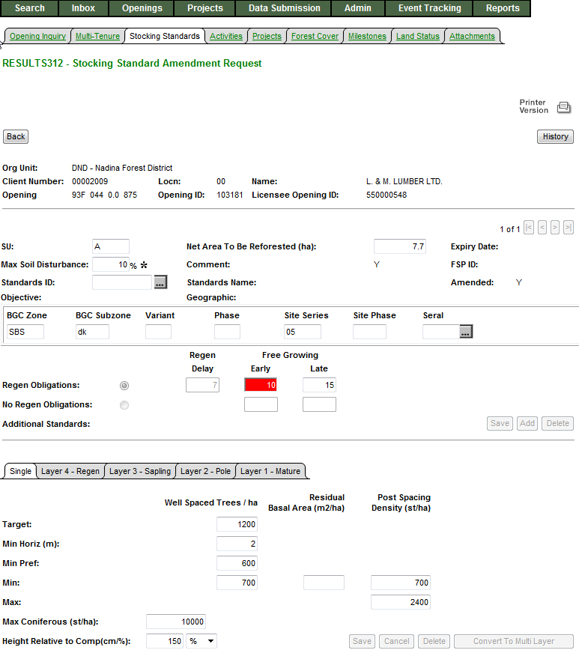
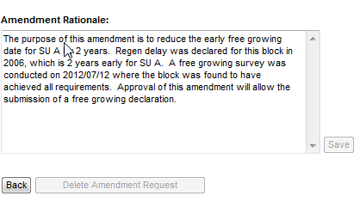
Silviculture Prescription Amendment (Proposed Amendment)
Status is in “SUB” status.
Cannot do approvals from S312 (View only). Approvals must be done in the S201 Inbox
All changes to the amendment is in Red.
Make sure review for all SUs for the opening.
Review the Amendment Rationale that provides context, reference to additional information (if provided attachments), etc.

Slide 9
RESULTS –Amendment requiring approval
Inbox – RESULTS Approver role
“SUB” status will not allow declaration and any attempt for any other SU modifications due to pending review.
Must “Approve” or “Not Approve” to enable opening to be available for next steps.

Slide 10
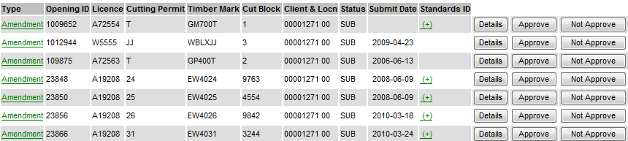
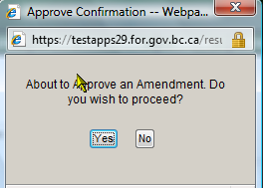
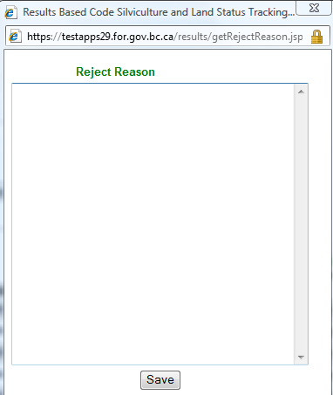
RESULTS –Amendment requiring approval
Inbox – RESULTS Approver role
S201 – Inbox Search
Ministry personnel must have “Approver” role to action.
Details Take to S310 – to enable review of Submitted Proposal.
Approve Will approve Submitted Amendment –
Opening will change from “SUB” to “APP” status
-----------------------------------------------------------------------------------------------------------------
Not Approver: Requires mandatory reason to explain reason for not approval.
Approve Opening change from “SUB” to “AMD”
Submitter: Make decision for next step:
Delete Amendment – change from “AMD” status to “APP” to start over
Modify existing Proposed Amendment to resubmit – change from “AMD” to “SUB”

Slide 11
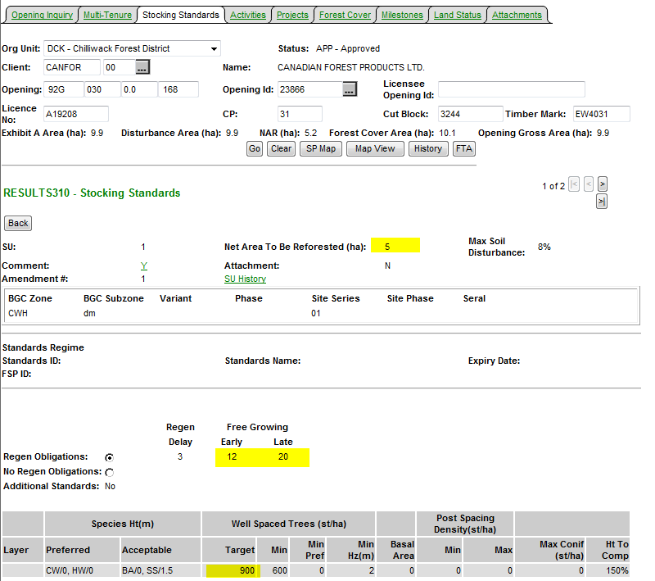
RESULTS –Amendment requiring approval
Inbox – Approved Opening
Upon Approval – Status changed to “APP”
All changes from the Amendment is now reflected current S310-Stocking Standards.
SU History & History contains Audited changes.

Slide 12
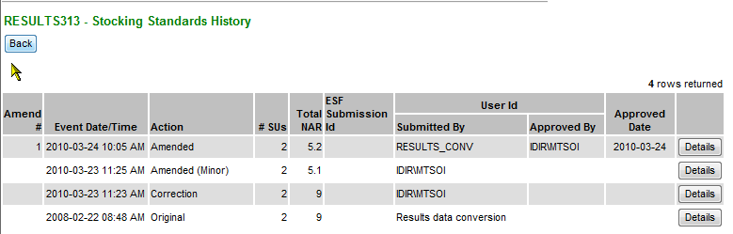
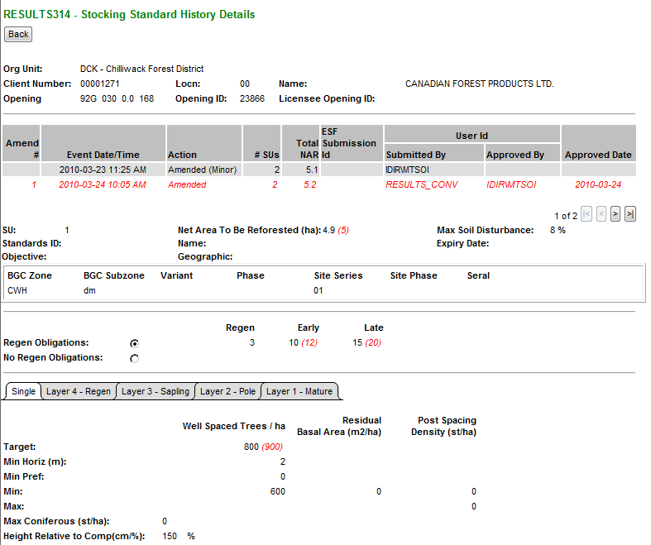
Auditing – SU History
Upon Approval – Status changed to “APP”
All changes from the Amendment is now reflected.
SU History & History contains Audited changes.
Changes items from the Action is in (red).
Only has changes effective March 11, 2008 (date which this infrastructure was created)

Slide 13
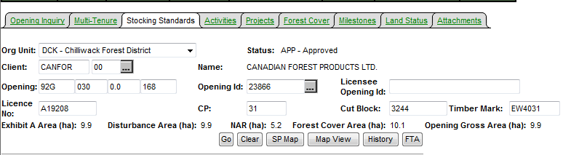
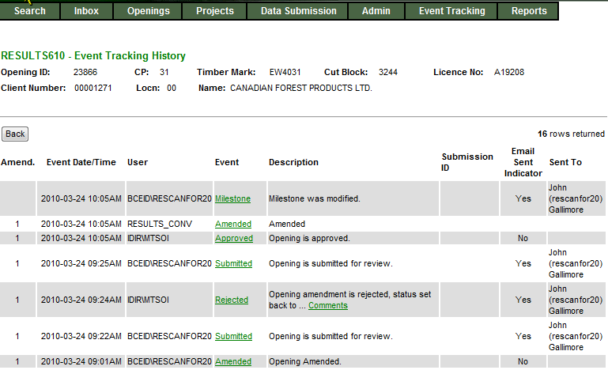
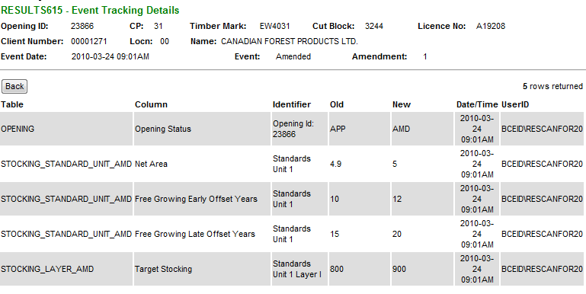
Auditing – History
S610 History provides each of event.
SU History data can also be accessed from S610.
History provides tracking of individual element changed

Slide 14
RESULTS – Silviculture Prescription Amendment– Flow
Online
Approve
APP
AMD
SUB
APP
Changes reflected and audited
Not Approve
Submit
AMD
SUB
Delete
APP
ESF
Approve
APP
SUB
APP
Changes reflected and audited
Not Approve
AMD
No changes reflected
Submitter to respond
As required on their respective forest management system

Slide 15
s.108 Application

Slide 16
RESULTS FRPA s.108 Application
Overview of FRPA s.108 – Legislation
Requirements for s.108 Application using RESULTS
Steps to complete the processing a s.108 Application (Inbox)
Show key s.108 documentation links

Slide 17
s.108 Application - Legislation
FRPA s.108 – Government may fund extra expense or waive obligation
Because of an event causing damage (FPPR s 96 (1.1)), the obligation to establish a free growing stand cannot be met without significant expenses than would have been the case if the damage had not occurred, and
The person
  did not cause or contribute to cause of damage,
  exercised due diligence in relation to the cause of the damage, or
  contributed to the cause of the damage but only as a result of an officially induced error.

Slide 18
s.108 Application - Legislation
Minister must grant
  Relief of obligation, or
  Grant funding to restore stand of trees on the area affected by the event to the stage the stand had reached at the time of damage or to a stage that is consistent with an agreement between the person and the minister.

Slide 19
Must be Current on Reporting to submit s.108 Application
Submissions that must be in RESULTS before the s.108 Application process
  Pre-event forest cover: to reflect pre-catastrophic event stand condition. Note: this should be submitted first if not already in RESULTS.
  Post-event forest cover : to reflect forest stand condition after the catastrophic event.
  Submission of new disturbance activity to reflect catastrophic event

Slide 20
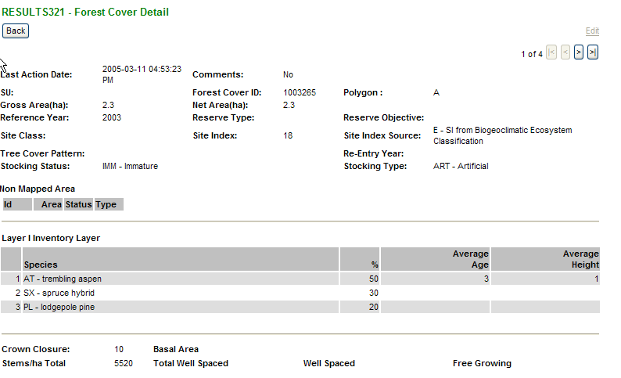
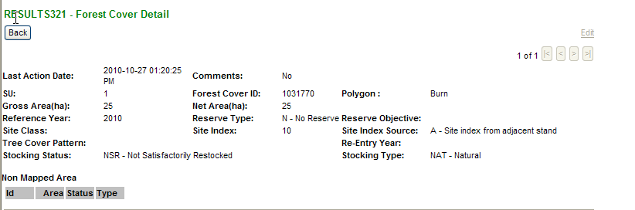
s.108 – Pre and Post Condition
Ensure Forest Cover Up-to-Date
Pre-Catastrophic Event Forest Cover
Requires forest cover up to stand condition before catastrophic event.
If not in RESULTS, submit this first.
Wait a day.
Then submit forest cover reflecting after the catastrophic event.
Post-Catastrophic Event Forest Cover

Slide 21
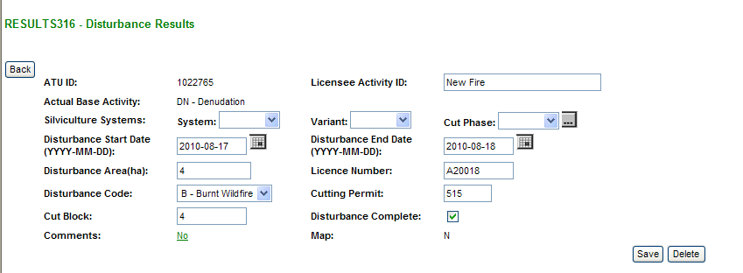
s.108 – Disturbance Report for Catastrophic Event
Disturbance Record must exist for catastrophic event

Slide 22
s.108 – Retain Data Integrity
Do not change the initial disturbance start date for the opening as this still applies to the original obligation of the opening.
Must supply new disturbance to reflect new catastrophic disturbance. The disturbance area should reflect the net area under the s.108 Application seeking relief of obligation or funding request.
New disturbance will not change the regeneration and free growing milestone dates.
Must submit an amendment to extend regeneration & free growing dates and/or modify stocking standards.

Slide 23
RESULTS – Modifications to Stocking Standards
Requirements to Modify Stocking Standards:
Silviculture Prescription: Create and submit silviculture prescription amendment (requiring approval)
Site Plans: Will need to submit a new stocking standard
    a) Site plans under FDP: New standards must be submitted to RESULTS
    b) Site plans under FSP: New standards must be submitted via the FSPTS and constitute an FSP amendment requiring approval.
    Unless FSP has some language allowing for stocking standards modification via approved variations
    e.g. For standard units where a natural disturbance occurred after area was reforested, the FG/RG offsets may be amended via approved variation to accommodate the disturbance

Slide 24
s.108 Application – Silv Prescription Amendments
May need to initiate an amendment to accommodate changes caused by catastrophic event (NAR, extension of regeneration and free growing years, etc)
Amendments should be completed and submitted prior to s.108 Application creation.
This ensures the amendment is indicated and reflected in the s.108 Application.
Approval of s.108 Application will also approve silviculture prescription at the same time.
Approver must ensure they review content of the Proposed Amendment in the process of s.108 Application Review

Slide 25
RESULTS – s.108 Approver Review Steps
Ensure all pre-requisite information is in RESULTS (pre & post forest cover and natural disturbance report) and authorization boxes are checked. Note relief of obligation vs. request for funding.
If applicable, review submitted silviculture prescription amendment or if site plan.
(Approver) Reviews s.108 Approves or Not Approves s.108 Application
  Approved: s.108 is in Approved (APP) status and cannot be changed.
  Not Approved: s.108 Application remains in system in (DFT) status and can be deleted by submitter and start new or modified for re-submission.

Slide 26
s.108 – Application Components
Component | Relief of Obligation | s.108 Application for Funding
Relief of Obligation | ✓
Disturbance Event (Catastrophic Event) | ✓ | ✓
Forest Cover Pre-catastrophic event stand condition and map | ✓ | ✓
Forest Cover Post-catastrophic event stand condition and map | ✓ | ✓
Planned Activity Regime |  | ✓
Silv Amendment, if required Note: site plan amendment do not require approval
Attachments , if required
Eligibility Check Boxes | ✓ | ✓
Authorization Check Box | ✓ | ✓

Slide 27
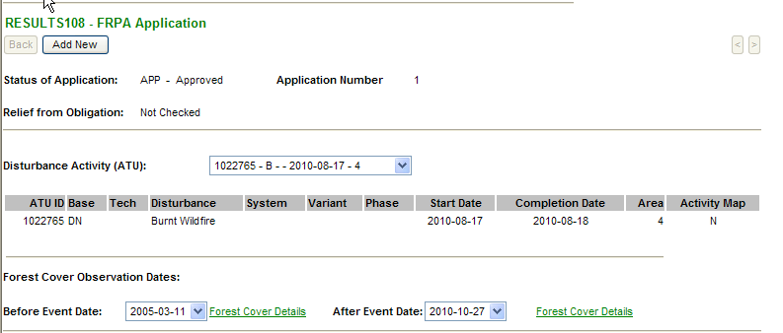
RESULTS – FRPA s.108 Application components
Mandatory
Disturbance Event
Pre & Post
Forest Cover
Then Save, located on bottom of page to confirm and initiate application
These are not enterable fields.
They reference existing submitted disturbance and forest cover records.
Must have disturbance pre and post forest cover submitted before initiating s.108 Application process

Slide 28
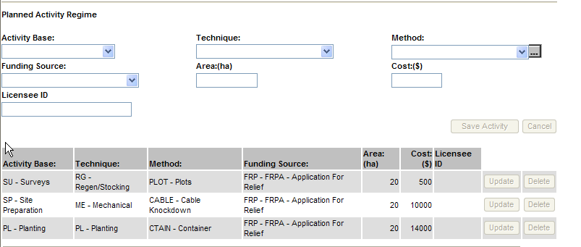
RESULTS – FRPA s.108 Application components
Mandatory for Funding Request
Add activities and funding request
Use “FRP-FRPA Application for Relief” funding source
Select “Save Activity”
As each activity is added, the list of s.108 funding activities area/cost will increase.

Slide 29
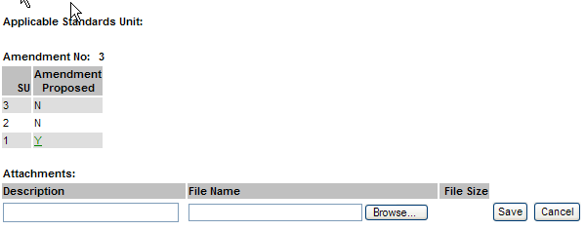

RESULTS – FRPA s.108 Application components
Optional
If a silviculture prescription is required and submitted as part of s.108 Application, the SU with required changes are shown and can be viewed.
May use attachment to provide additional information, if required.
If use Attachments please refer to Attachment Standard
Located on RESULTS Business & Policy website under Submission Procedures:
http://www.for.gov.bc.ca/his/results/business.htm
http://www.for.gov.bc.ca/his/results/RESULTS_Attachment_Standard_for_Government_Funded_Programs_20100716.pdf

Slide 30
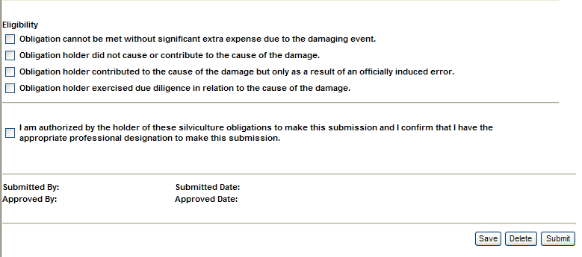
RESULTS – FRPA s.108 Application components
Mandatory
Must check required Eligibility Box(s)
Mandatory
Authorization to complete application
Save - After each section is completed to ensure all components are saved
Delete - Will delete entire application
Submit - Will submit application to reviewer. Application’s status changes from DFT to SUB

Slide 31
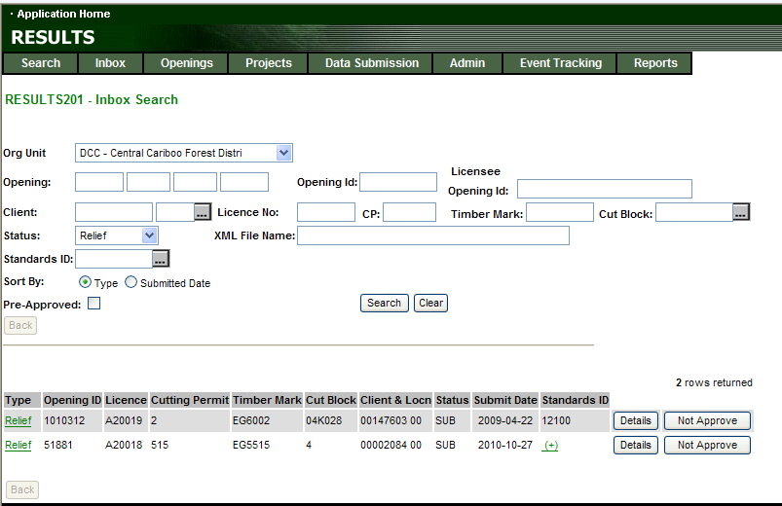
s.108 Application – Inbox Processing
Toolbar – Inbox
Status: Relief
Search

Slide 32
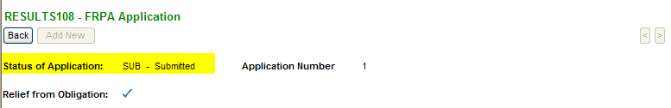
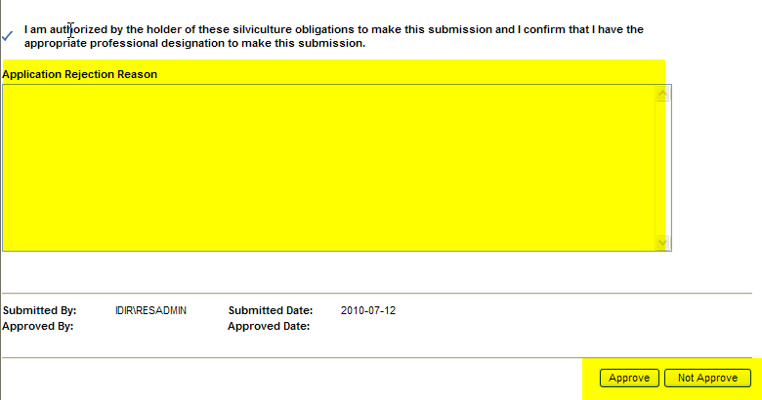
RESULTS – Review s.108 Application – Inbox Processing
Inbox – Details
Must view s.108 Application to access Approval Button.
Not Approval requires completion of the “Application Rejection Reason” text

Slide 33
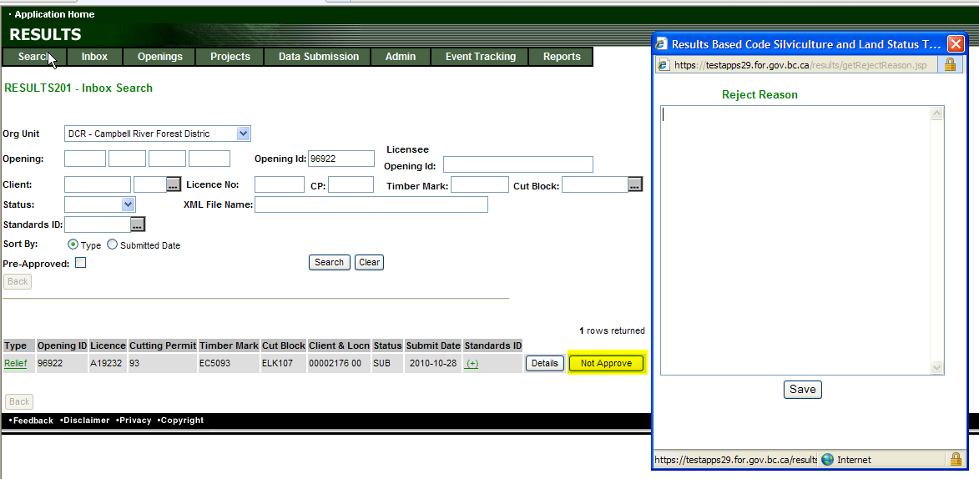
RESULTS – Review s.108 Application –
Inbox Processing
Can “Not Approve” from S201 but must provide Reject Reason (mandatory).
To review s.108 – Application – Go to Details
Upon Approval or Not Approve – email notification is sent to submitter

Slide 34
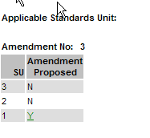
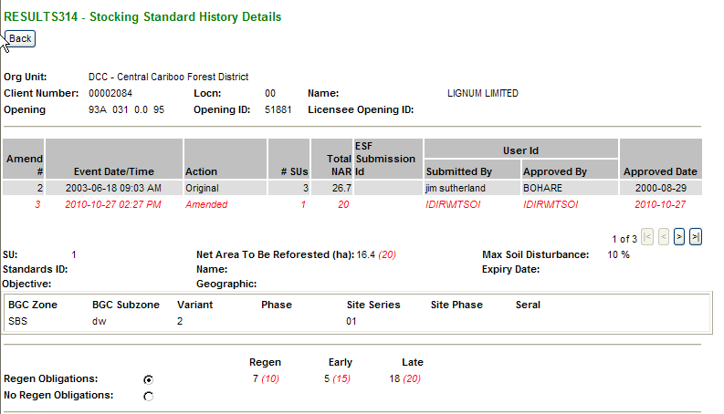
RESULTS –s.108 Application Approval
Silv Prescription Amendment - Approved
Care must be taken to review the Proposed Amendment if supplied with s.108 Application
Silv Prescription amendment is approved at the same time upon s.108 Approval.

Slide 35
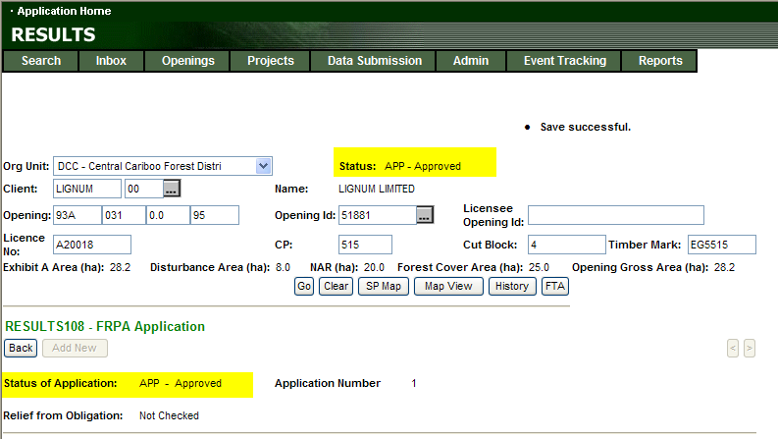
RESULTS –s.108 Application Approval
Approval Changes
Opening Status to Approved – APP
Relief of Obligation Status set to Approved – APP
Approved Application cannot be modified after approval.

Slide 36

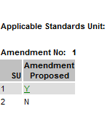
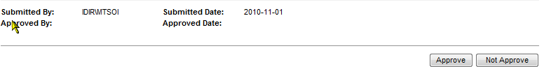
RESULTS – FRPA s.108 Application
S.108 Application Approves s.108 Application AND Silviculture Prescription Amendment as one step.
Make sure review any proposed amendment in s.108 Application

Slide 37
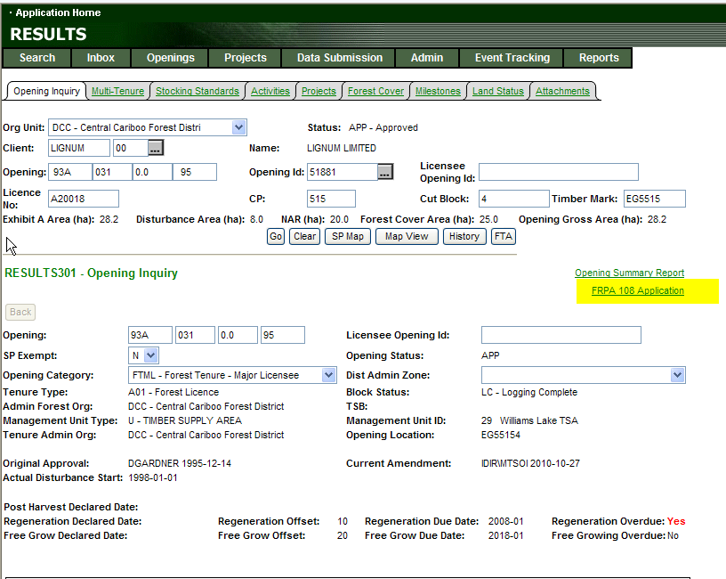
RESULTS –s.108 Application
S301 – shows opening with FRPA s.108 Application

Slide 38
RESULTS – FRPA s.108 Application
New Catastrophic Disturbance
(online or ESF)
s.108 Application
Inbox
s.108 Application
Ensure Pre-catastrophic Forest Cover exists if not Submit (ESF) – then must wait one day
Complete contents as required
Initiate s.108 Application
Approval of s.108
Application will approve BOTH
s.108 Application AND
Silviculture Prescription Amendment
Opening Status APP
Post catastrophic Forest Cover exists(ESF)
Opening Status SUB
If Required Amendment
Create and Submit Amendment
Submit s.108 Application for Approval
Opening Status APP
Site Plan Amendment

Slide 39
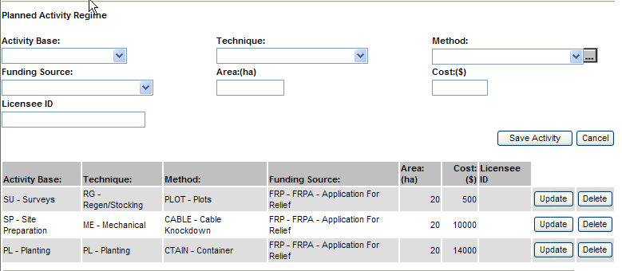
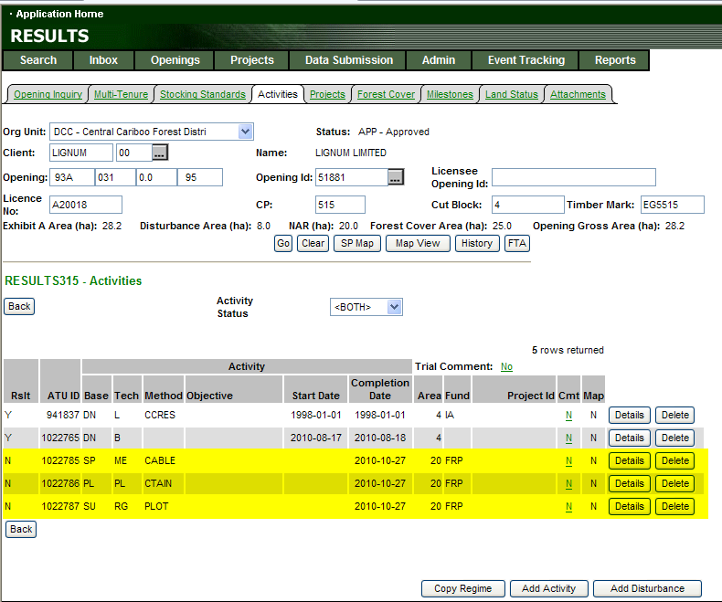
RESULTS –s.108 Application Approval
Placement of Planned Treatments
s.108 Approval
Automatically places all planned activities into S315
Activities as planned activity with planned start date based on approval date.

Slide 40
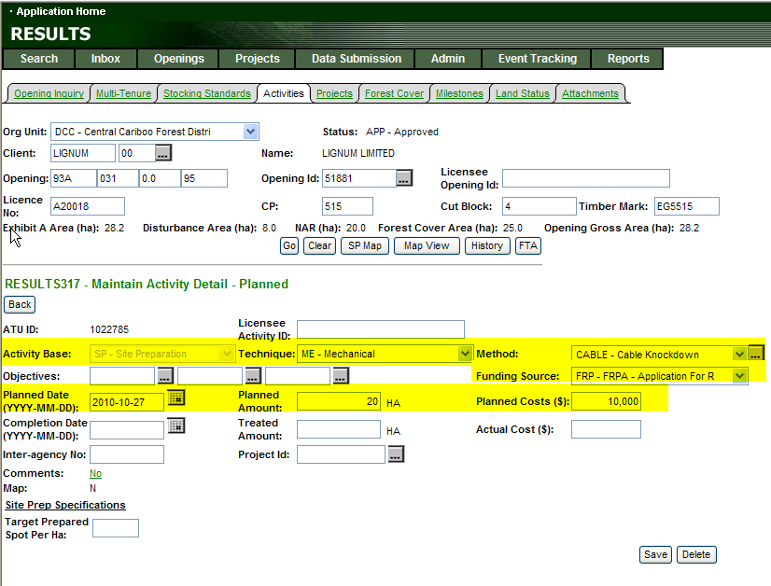
RESULTS –s.108 Application Approval
Placement of Planned Treatments
Planned Activities
Automatically created are:
Base/Tech/Method
Planned Date = s.108 Approval Date
Funding Source Code
Planned Amount (area)
Planned Cost ($)

Slide 41
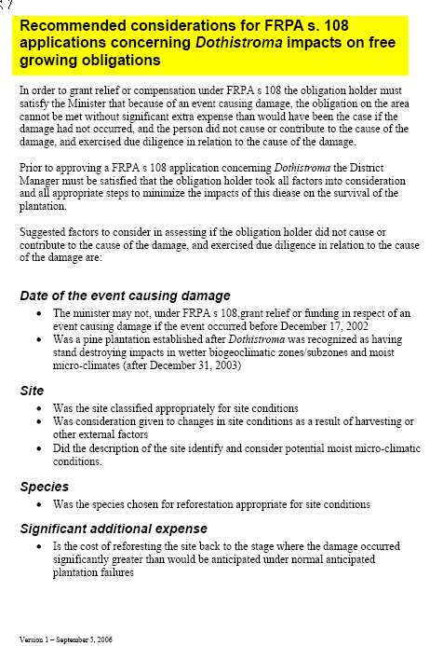
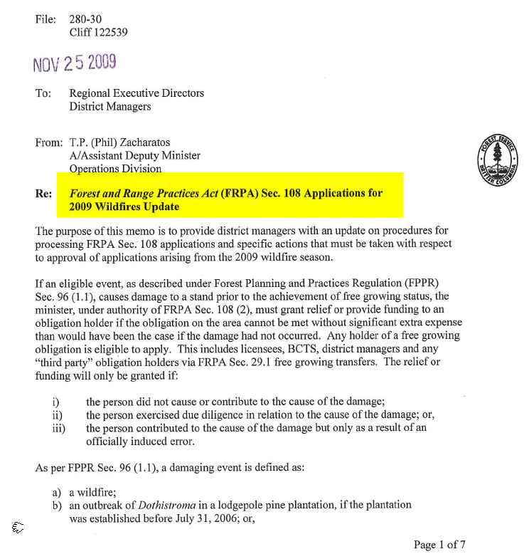
RESULTS – s.108 related
Communication & documentation http://forestsfortomorrow.com/fft/

Slide 42
RESULTS - s.108 Approval Guidance
Need to communicate with program lead on s.108 budget, unit costs and/or any direction on approvals
All approved s.108 tracked in RESULTS with funding request is reflects true cost of funding allocation.

Slide 43
Amalgamation

Slide 44
Amalgamation - AMG
Requirement to merge multiple cutblocks to be managed under one opening
Openings must belong to same org unit ands same client
Upon approval, Amalgamation stacks all SUs, all Activities and All Forest Cover together (automatically renumbers SUs and FC polygons - a big mess), so expectation is that amendment to SUs and new Forest Cover will be provided shortly to clean up opening.
There is no system’s check for the post-amalgamation clean up – so this must be locally monitored.

Slide 45
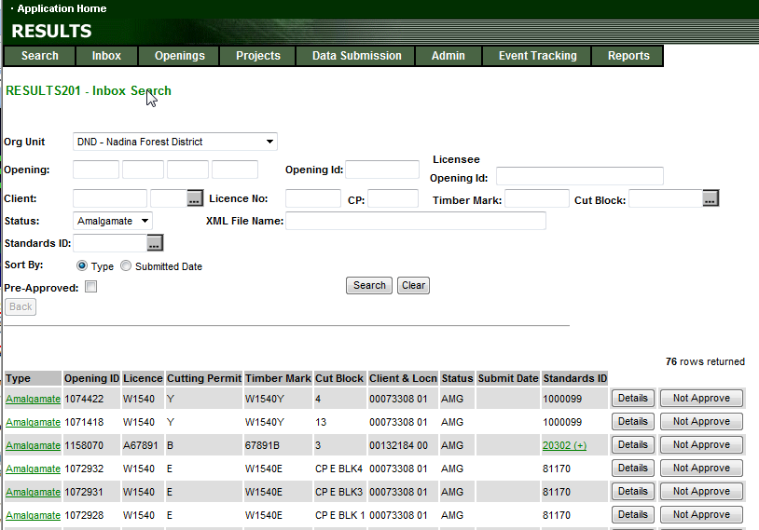
Amalgamation - AMG

Slide 46
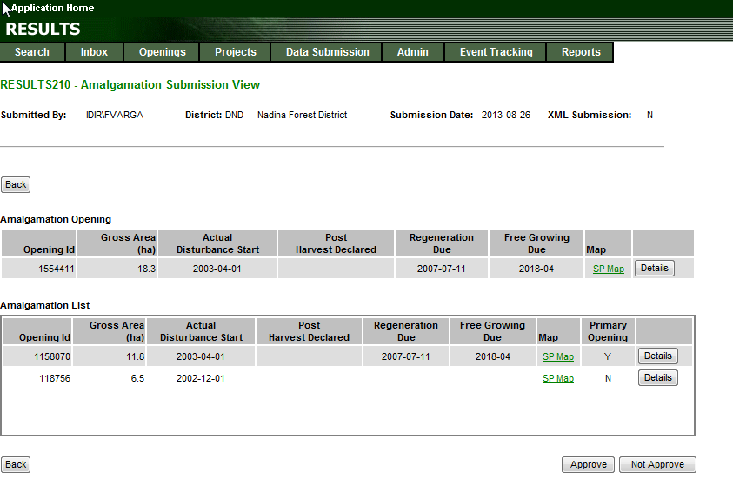
Amalgamation - AMG
Amalgamation opening represents the new opening (ie. 1554411) if approved with the combined information based on the amalgamation list.
It does not exist yet until there is an “Approve”.
If “Not Approve”, the new proposed Amalgamation Opening ID (ie. 1554411) will not exist.
Must review each of the amalgamation list items to ensure you are in agreement with the proposed amalgamation.

Slide 47
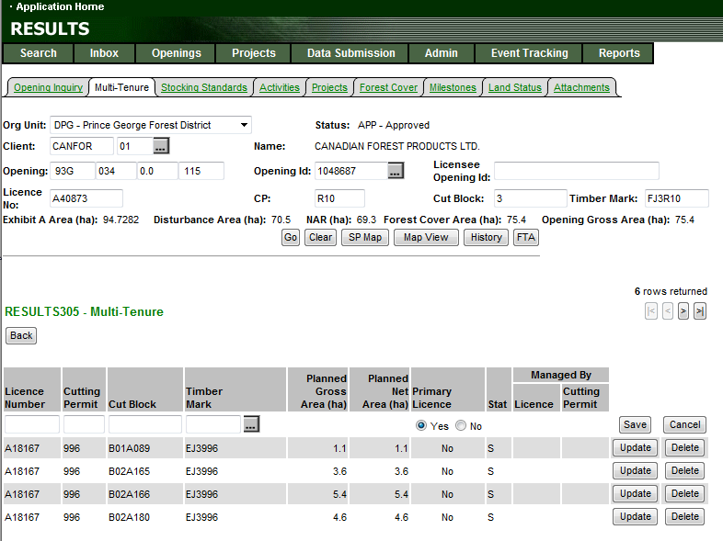
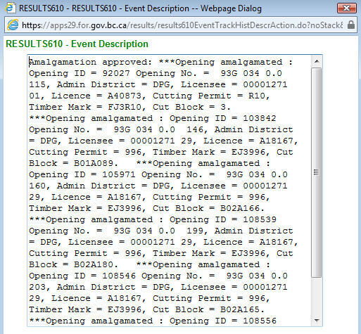
Amalgamation - AMG
Upon Approval, the new opening will be created (ie. 1048687) with all the pre-existing opening’s data stacked (all tenures, standards unit, activities, forest cover, declarations, attachments).
Historical Opening ID reference can only be found through History via Event Description Comments.
Old Opening ID is no referenced and has been re-assigned to the new Opening ID.

Slide 48
Proposed Stocking Standards
(Standards Regime ID)

Slide 49
Proposed Stocking Standards
(standards regime id) in RESULTS
RESULTS contains:
  FDP stocking standards
  Ministry Defaults
  Default woodlot stocking standards
There may be a requirement to propose new FDP or Woodlot stocking standards.
Any new standards associated with FSPs come through FSPTS application. Stocking standards approved through the FSPTS is available for use in RESULTS for the applicable client and/or org unit.

Slide 50
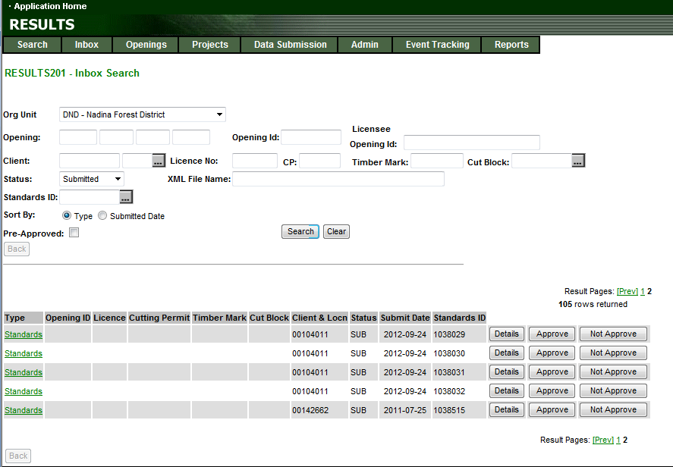
Proposed Stocking Standards in RESULTS

Slide 51
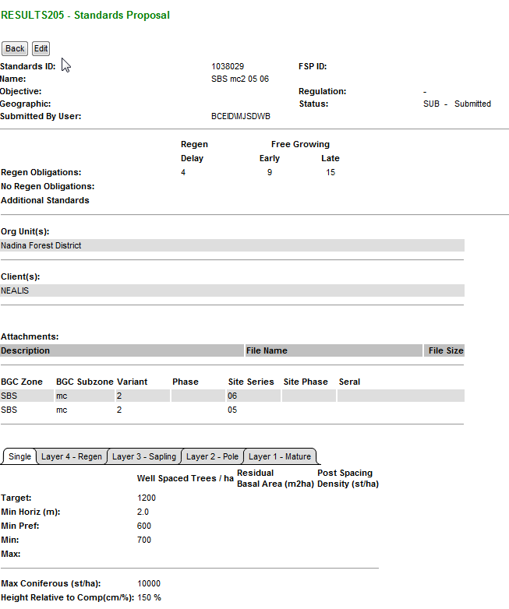
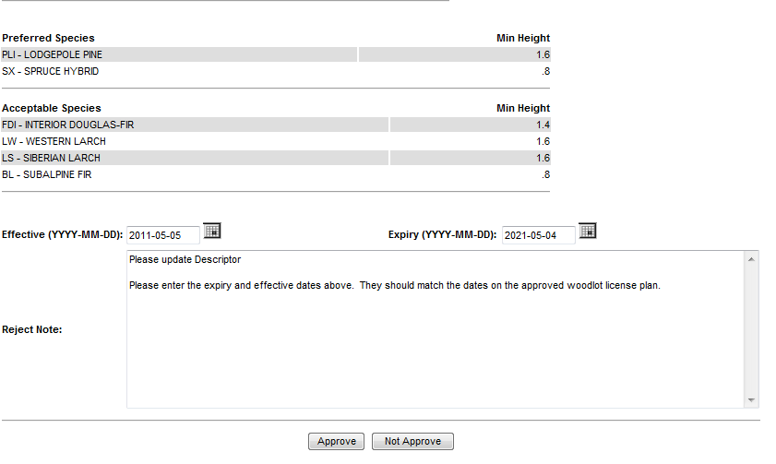
Proposed Stocking Standards in RESULTS
Submitted Standards are not available for use until Approved.
Review submitted stocking standards.
Any previously reviewed Reject Notes will appear for reference.
Can approve or not approve from this screen or go back to Inbox.
Not approve requires reason in the Reject Note section.

Slide 52
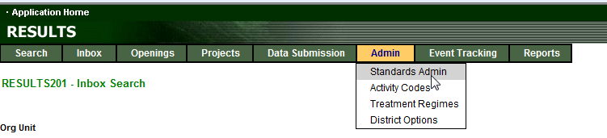
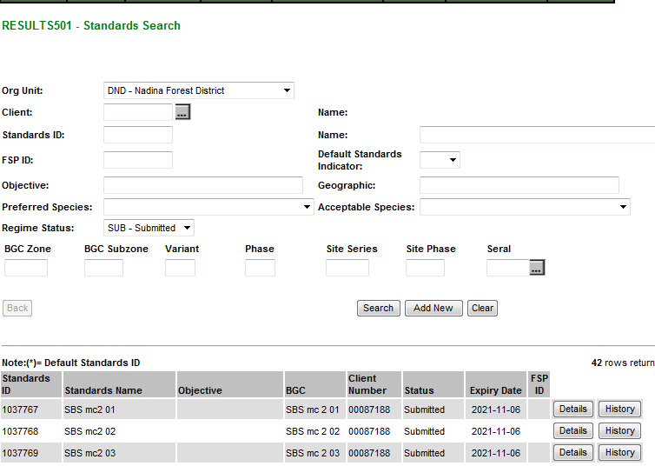
Proposed Stocking Standards in RESULTS
Admin – Standards Admin
Allows you to review all Submitted Standards and review details and History.
Approvals must occur from the Inbox
But may review Details and History (Submitted, Rejected and Approvals and any associated notes.)

Slide 53
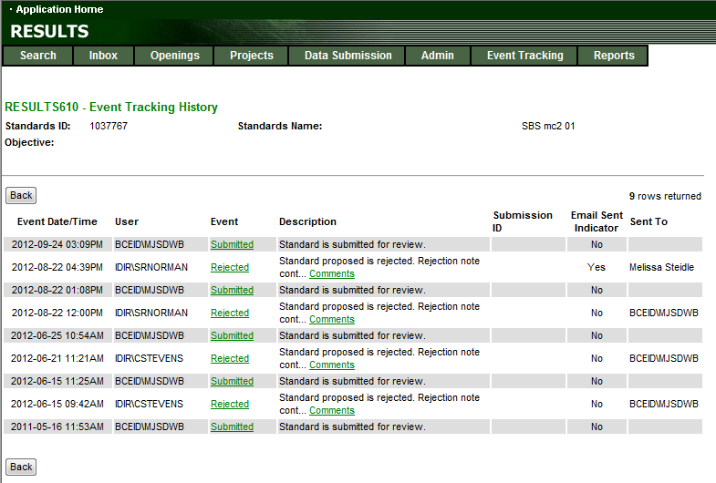
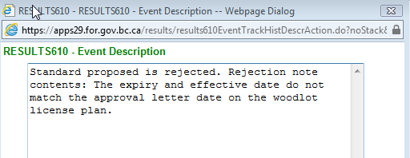
Proposed Stocking Standards in RESULTS

Slide 54
Approver Responsibilities
Must be legal context, if applicable (silv prescription amendment);
Must be familiar with program directives, if applicable (s.108 application where funding applies, if approved must reflect funding availability) or any policy direction
Amalgamation ensuring that there is adequate follow up to clean-up opening post-approval
Proposed stocking standards is appropriate and there is nothing that is already available and it done through the proper process (FDP vs. FSP)

Slide 55
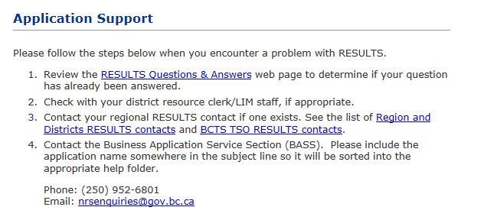
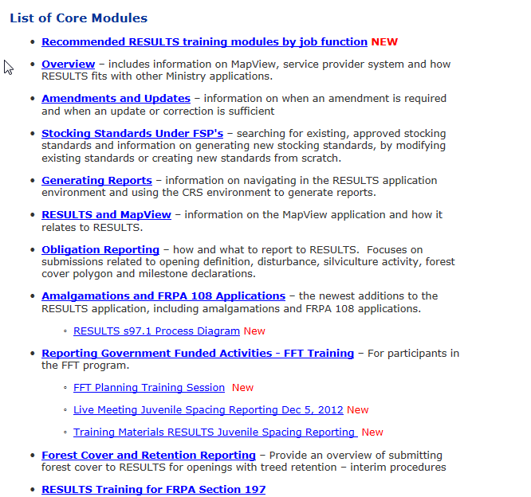
Help Resources
http://www.for.gov.bc.ca/his/results/support.htm
http://www.for.gov.bc.ca/his/results/training/index.htm
E-Stand Enhancement

